Slide 1

ITA0521-Computer Vision
Computer Vision in Agriculture
Presented By:
NEELAKANDAMOORTHY.C(192421063)
Guided by:
DR.T M USHA

Slide 2
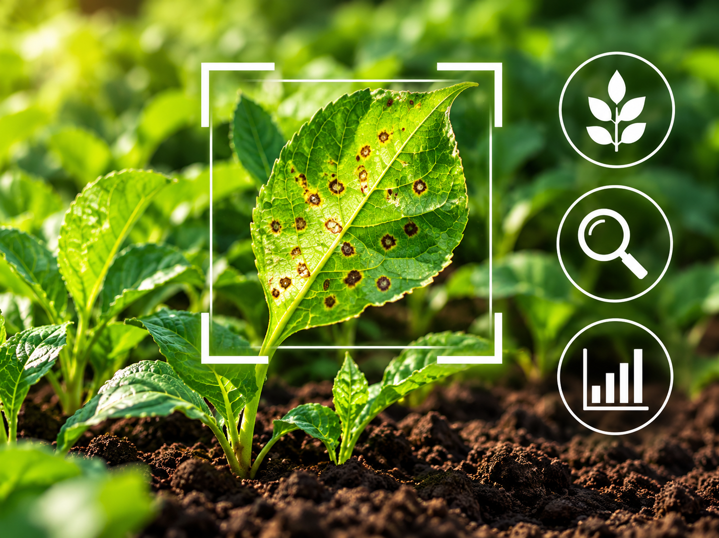
INTRODUCTION
Agriculture is important for food production and the economy.
Farmers need to identify plant diseases, weeds, and crop problems early.
Computer vision allows computers to understand images and videos.
It uses cameras and AI to examine crops and help farmers make decisions.
It can support faster, more accurate, and more efficient farming.

Slide 3
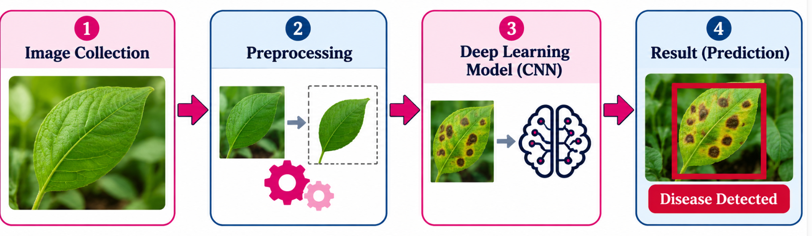
HOW DOES IT WORK?
1
2
3
4
Capture Image
→
Process Image
→
Analyze with AI
→
Show Result
Phone, camera, drone
Clean and resize
Detect disease or weeds
Alert or recommendation

Slide 4
ADVANTAGES
Early disease detection can help reduce crop damage.
Saves time by checking many plants or large fields quickly.
Can identify weeds and support targeted weed control.
Helps monitor crop growth and estimate fruit or plant counts.
Supports data-based decisions and more efficient use of resources.

Slide 5
REAL-WORLD APPLICATIONS
Plant disease detection: recognizes visible symptoms on leaves.
Weed detection: distinguishes weeds from crops for targeted spraying.
Fruit counting: estimates the number of fruits before harvesting.
Crop monitoring: observes growth, color, and signs of stress.
Drone and satellite imaging: helps inspect large farms and identify problem areas.

Slide 6
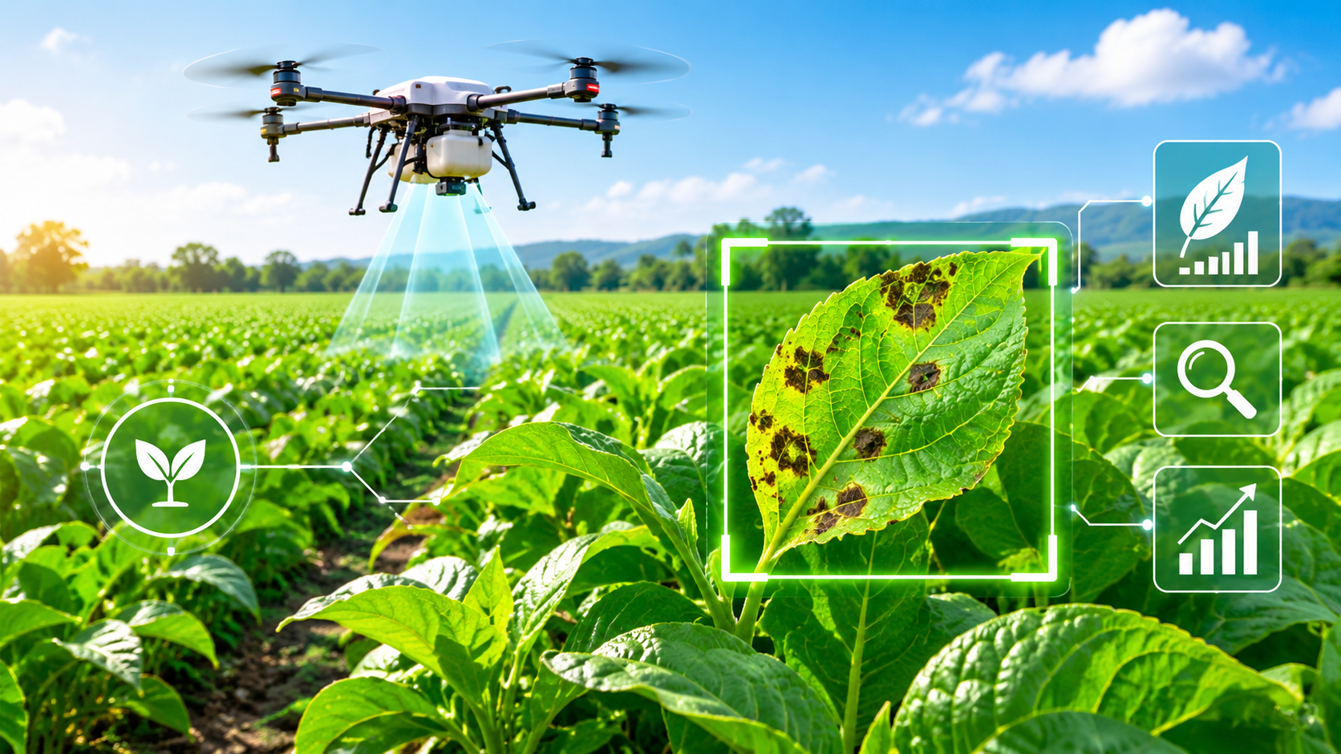
FUTURE SCOPE
More accurate AI models for different crops and local conditions.
Smartphone apps that provide quick crop health checks.
Robots and drones that monitor fields with less manual work.
Combining computer vision with sensors and weather data.
Precision farming that reduces waste and supports sustainable agriculture.

Slide 7
CONCLUSION
Computer vision helps computers understand crop images.
It can detect diseases, identify weeds, count fruits, and monitor growth.
It can save time and help farmers make better decisions.
Image quality, cost, and model accuracy remain important challenges.
With continued improvement, it can play a valuable role in smart farming.

Slide 8
THANK YOU
.

